Slide 1
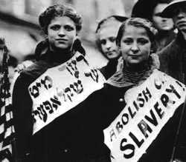

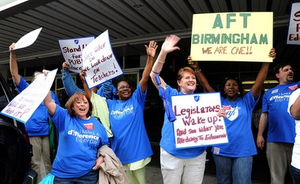
Unions:
Past, Present & Future
Add: Old Photo, New Photo & Future Photo to contrast each other

Slide 2
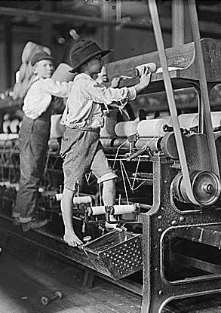
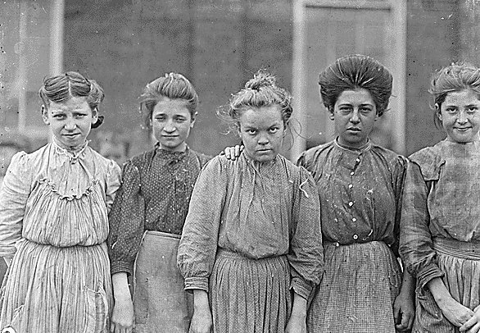
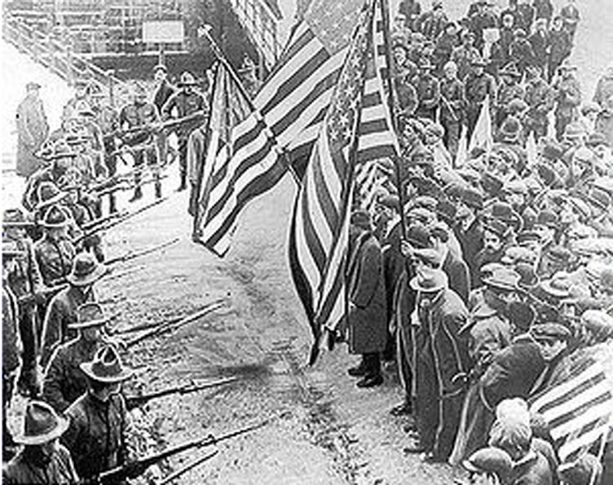
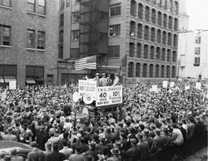
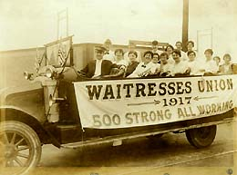
Why are Unions Important?
Ended Child Labor
In 1938, President Franklin D. Roosevelt signed the Fair Labor Standards Act, which, placed limits on any forms of child labor. Unions played a key role in achieving this.
Standardized
40 Hour Work Week
Won by many unions by 1900, it became law for all Americans in 1937 with the creation of the Fair Labor Standards Act.
Status of Women in the Workplace
The Equal Pay Act 1963 made it illegal to pay women lower rates for the same job. Women earned 59% of men’s wages. Even today that rate is about 84%.

Slide 3
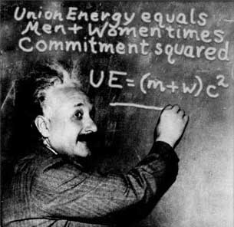
Why are Unions Important?
Overall Benefits of a union:
Workers in a union have:
higher wages (11.2% more than what nonunion workers make)
employer-provided health insurance (96% compared to 69%)
access to paid sick days (93% compared to 75%);
retirement benefits through private employers (82% to 48%); and
guaranteed pensions through private employers (54% to 8%).
Unions Improve Pay and Working Conditions for All Workers—Especially Workers of Color:
The union advantage is even greater for people of color, women, immigrants, and others who have confronted workplace discrimination. A union contract is a potent weapon against unequal pay and structural racism because it establishes fair and transparent systems for hiring and firing, wages and more.
Black, Latino and women workers are paid 26%, 39.2% and 23.8% more, respectively, when they belong to a union. Union contracts pay women and men the same for doing the same job. You cannot be fired for your sexual orientation or gender identity under a union contract.

Slide 4
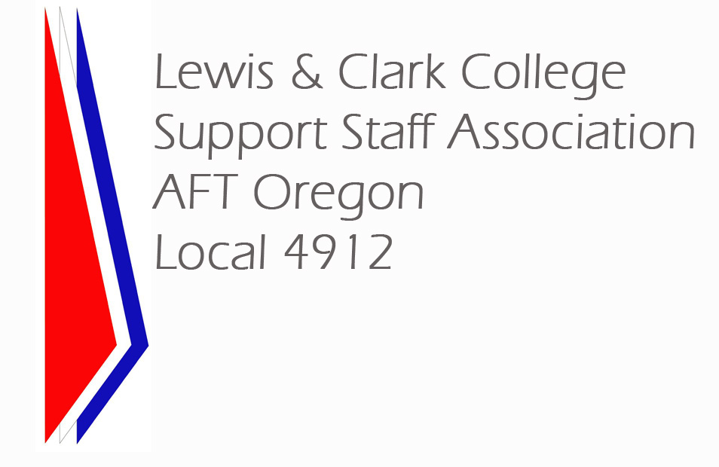

Our Union: LCCSSA
Who are we?
Support Staff Association (LCCSSA), Local 4912, is affiliated with the AFT-Oregon, American Federation of Teachers, AFL-CIO.
Campus Safety Officers were not part of the originally formed union. However, when they expressed interest in joining the unit we negotiated with the College and they joined LCCSSA December 2013
When did we start?
In the summer of 1987, after much discussion, research, and review, the support staff voted to affiliate with John Bailey & Associates, and in the fall filed a petition to become its own bargaining unit with the National Labor Relations Board. LCCSSA ratified its first contract between Lewis & Clark College and the LCCSSA on August 9, 1988. A number of years later, in 1994, the members voted to affiliate with the American Federation of Teachers (AFT). We have been an affiliate of AFT since April of 1995.

Slide 5
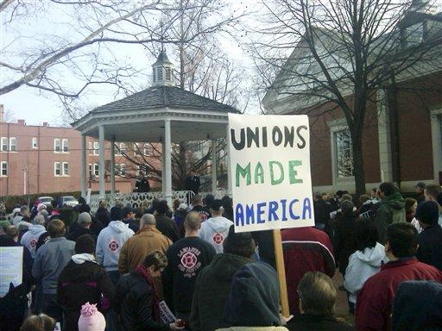
State of the Union(s)
Beginning of the Decline
Unions have been declining since 1955, but in absolute numbers most of this occurred since 1981.
In 1973 one in four (18 million) workers belonged to a union. (private and public sectors).
In 2008 only one in thirteen workers in the private sector (8.2 million) belonged to a union, and one in three belonged within the public sector (7.8 million).
In 2022 wage and salary workers represented by a union include both union members (14.3 million) and workers who report no union affiliation but whose jobs are covered by a union contract (1.7 million). This means only 10.1% of wage and salary workers are represented by a union.
As union membership steadily declined, income inequality began to steadily rise after a trough in the 1970s. In 2022, union membership plateaued at 10 percent of workers while the top one percent of income earners earned almost 20 percent of total income.

Slide 6
State of the Union(s)
Court Decisions
Organizing campaigns: Legally workers can organize, but workers can be fired trying to organize and have little redress. The US Labor Relations Board used to take two years to make a decision (compared to Canada which can have a decision within two weeks), but new legislation requires that it be made within 45 days. Workers must have 30% yes-vote to create a union, but courts have said they cannot have access to the work force or property.
Employer Litigation: June 2023, the Supreme Court handed employers one more tool to use in trying to squelch worker organizing: the threat of a state court lawsuit for economic harm. In Glacier Northwest Inc. v. International Brotherhood of Teamsters Local Union No. 174, the Supreme Court upended decades of labor law precedent by allowing an employer to file a lawsuit for damages caused by spoilage of a day’s worth of product during a strike.
Right to Strike: While the law (even internationally)¹ says workers have the right to strike, U.S. judges have said workers who strike can’t be fired but can be “permanently replaced”.
Reagan Anti-Union Policies: In 1981 President Regan fired 11,000 striking air traffic controllers by allowing employers to use “permanent” replacement workers, thus negating the law giving workers the right to strike.
        ¹ Article 23 of the Universal Declaration of Human Rights identifies the ability to organize trade unions as a fundamental human right.

Slide 7
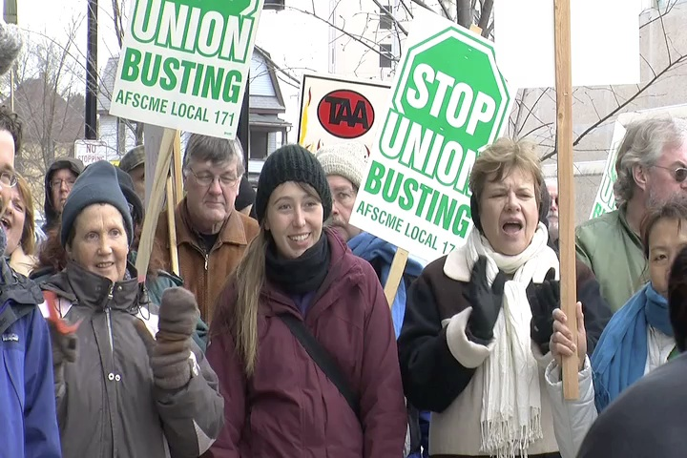
State of the Union(s)
Today: Unions have begun to take more aggressive action
AFT Political Actions: Many AFT Locals, as well as the national organization, educate and fight for such things as working to stop states from placing restrictions on voting, preventing subsidized federal student loans from having their interest rates raised, improving the quality of public education issues.
More Action in the Courts & NLRB: Unions continue to fight in the courts to maintain the right to collective bargaining, despite the hostile attitude of the courts to unions. In the first quarter of 2023 Unfair labor practice (ULP) charges filed across the NLRB’s 48 field offices have increased 16%.
More Organizing: Organized labor appears to be having a moment. After decades of erosion in the private sector, U.S. workers are organizing at a pace not seen in many years. In December 2021, a Starbucks in western New York became the first to unionize, sparking a wave of union elections in stores across the country. First-ever unions have also formed at an Amazon warehouse in Staten Island, an Apple store in Maryland, and an REI store in New York City. This recent wave of worker organizing is partially concentrated among younger and more educated workers and in industries–including the service sector, but also media, tech, and think tanks–that have resisted organizing activities in the past.
More Strikes: Some 362,000 workers have gone on strike so far in 2023, compared with 36,600 over the same period two years ago.

Slide 8
What’s in the Future:
Why are you represented by the union?
  The mission of the LCCSSA is primarily to oversee and safeguard the employment conditions of all members by promoting a positive working environment in conjunction with the Lewis & Clark community, and by negotiating a fair and equitable labor agreement. Your elected representatives care about and work for you.
Where are we now?
  Until 2016 it took16 years to reach the top of our pay grade. It now takes 5 years to start earning at our highest level. However, the Teamsters at L&C reach their highest pay in two years.
  2023, about 75% of our bargaining unit were women. In 2013 the majority of our unit earned less than $36,000 per year with an average of $32,000 per year. As of June 1, 2024, our median wage was $57,836.61 with an average wage of $57,134.59.
Where do we go from here?
  With inflation rates of the past several years being so high, even with the special adjustment in our contract we have still lost ground in terms of keeping up to the overall cost of living. We will need to continue to press things such as wage increases, and increased safety for Campus Safety Officers.

Slide 9
Overview of LCCSSA Bargaining Progress
2000-2023
Wage Increases:
2000 – 2003: $8.50 – 19.80 (no regulation of starting wages or regulated increases)
2003 – 2006: $8.76 – 20.91
2006: $9.48 – 21.46 (temporary agreement after 10 months bargaining)
2007 – 2010: $11.55 – 26.20
(after two years of bargaining; step system implemented; limited starting wage range)
2010: $12.52 – 26.20 (after nine months of bargaining)
2011: $12.77 – 26.72 (economic re-negotiation)
2012: $13.27 – 27.22
2013: $13.60 – 34.07
  (steps reduced to 16 years to reach maximum pay, with the addition of two new higher pay grades)
2014: $14.01 – 35.09
2015: $14.43 – 36.14
2016: $15.92 – 35.71
(over course of contract steps reduced resulting in five years to reach maximum pay much sooner; starting wages set amounts; wage table adjusted and equalized)
2017: $16.56 – 36.24
2018: $17.31 – 36.97
2019: $17.83 – 38.08 (steps to reach maximum pay: five years)
2020: $18.36 – 39.22
2021: $18.91 – 40.40
2022: $20.05 – 42.83
2023: $20.75 – 44.33
2024: $21.46 – $45.84

Slide 10
Overview of LCCSSA Bargaining Progress
2000-2023
Vacation Day Increase:
2003: 12 – 22 days per year (depending on length of service)
2007: 15 – 24 days per year (depending on length of service)
Sick Leave Increase:
2013: 22 days per year (previously 12 for <5 years employees and 15 days for >5 years)
Additional Holidays:
2007: Addition of MLK
Overtime Pay Designation:
2007: Overtime accrues after 40 hours of pay rather than 40 hours of work
2013: Overtime accrues after 37.5 hours of pay unless your normal work week is 40 hours
Temporary Pay Increase:
2007: After five consecutive days of doing a higher paying job (inside or outside the unit) you will be compensated at least $1.00 more an hour based on the higher salary
2013: Additional Compensation is set at $3.00 an hour
Swing Shift Premium:
        If you start work at noon or later you receive an hourly premium.
        2003: None
        2007: $.50 per hour after 4:00 p.m.
        2011: $1.00 per hour after 4:00 p.m.
        2019: $2.00 per hour 4:00 p.m. – 6:00 a.m.
        2022: $2.00 per hour weekends, and all hours starting 4:00 p.m. – 6:00 a.m.
Cost of Living Adjustment:
2019: A special COLA adjustment was added based on annual inflation rates

