Slide 1
Lewis & Clark
Transportation and Parking Advisory Committee (TPAC)
December 3, 2025 | 1:00 PM | Fowler 353

Slide 2
Agenda
Guests
T&P Update
T&P Survey Update
New Shuttle Route Update
EV Chargers
Open Discussion / Questions

Slide 3
Guests
American Association of University Professors (AAUP)
Alana Rader - Associate Professor of Environmental Studies
Partnering with TPAC to discuss alternative transportation options on campus.
AAUP Meeting - Thursday, Dec 4 - 9a - 10a

Slide 4
T&P Update: Permit Sales & Citations
Academic Year | Citations Total | Percent Diff | Permit Totals | Percent Diff
2022-23 | 1,748 | NA | 2,129 | NA
2023-24 | 2,642 | +41% | 2,389 | +11.5%
2024-25 | 2,858 | +8% | 2,704 | +12%
2025-26 (YTD) | 1,373 (on pace 3,000) | +5% if target met | 2,020 (on pace 2,700) | 0%

Slide 5
T&P Update: Miscellaneous
Fountain Gateway Avg Weekday (Mon - Th) Peak Hours 11a - 3p
  15-20 vehicles
  High 27 vehicles
  Fridays - Less than 10 cars
Current Lease $10,500 (Academic Year)
Spring Permits went on sale Dec 1
  Permit Enforcement begins Jan 20
  Reserved lot (Primarily 3L lot) First day of classes (Law)

Slide 6
T&P Survey Update
Survey Dates: Oct 5 - Oct 19
63% Employee response rate
ECO Employee Survey Results Submitted to DEQ on Oct 30 (Deadline Oct 31) - (Has been Approved by DEQ)
TDM Report
  Currently being compiled
  Deadline to submit Dec 31 (expected submission date Dec 20)
  TDM Report will be added to website after approved by PBOT (~Jan 2026)
  Will achieve targets

Slide 7
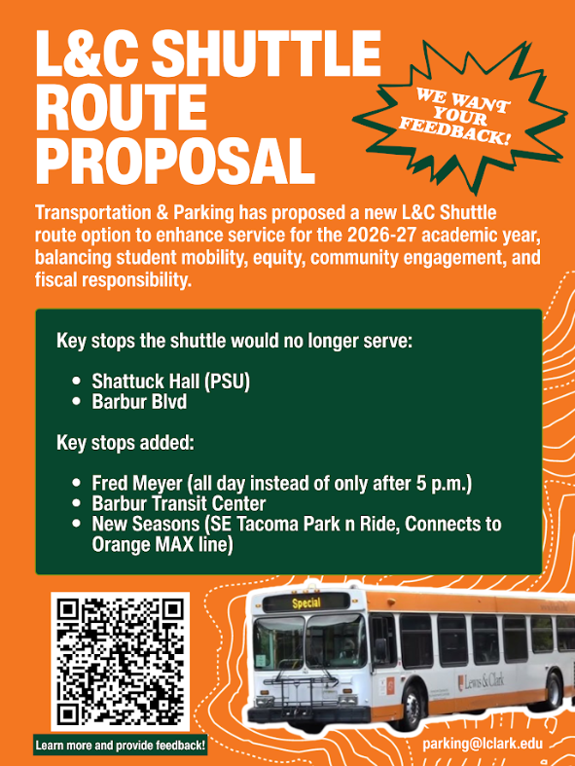
Shuttle New Route: Update
Outreach
  Met with SBA 11/16:
  Tabled in front of Bon (CAS): 11/18
  Met with Student Union (GSEC): 11/18
  Flyers created with QR code and put on Shuttle
    QR links to website detailing proposal with a feedback form that can be filled out.
Future Outreach
  Creating 3 Posters to place at entry to each Bon location (CAS, GSEC, Law)
  Placing flyers throughout campuses

Slide 8
Shuttle New Route: Update
Response Options - 15 total responses
  Current Route - 6
  New Route - 9
  No Impact (Don’t Ride) - 0
  No Impact (Will continue to ride) - 0

Slide 9
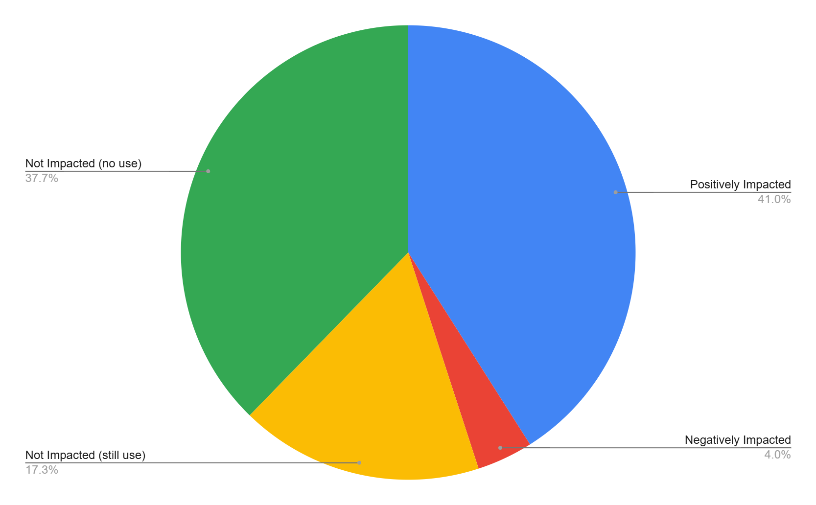
Shuttle New Route: Data Results
1278 Student Responses
Data shows how the change in route would affect travel habits broken down by how often they currently utilize shuttle.
Key Takeaway - 1278 Respondents
  Positive Impact: 524 (41%)
  Negative Impact: 51 (4%)
  No Impact (Still Use): 221 (17.3%)
  No Impact (No Use): 482 (37.7%)
  Data shows anyone that chose
    Ride more
    Riders that marked they ride daily (current) that marked no difference

Slide 10
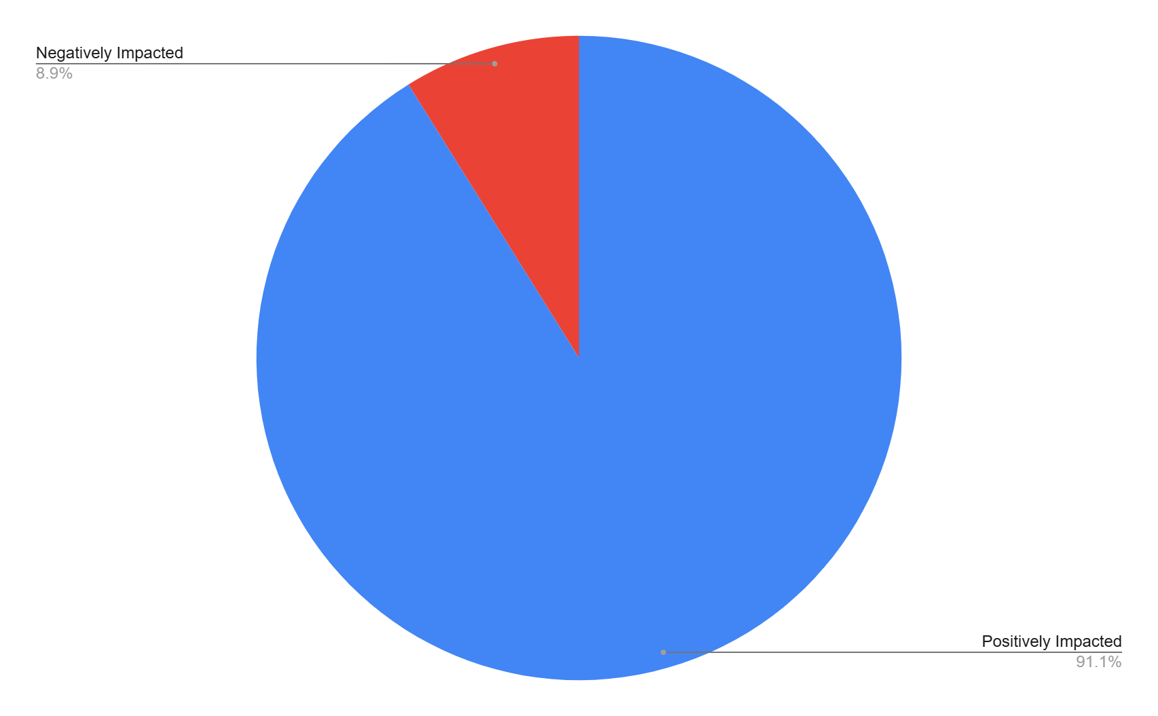
Shuttle New Route: Data
Positively Impacted - 524 (91.1%)
Negatively Impacted - 51 (8.9%)
Excludes: 482 students that won’t ride either option

Slide 11
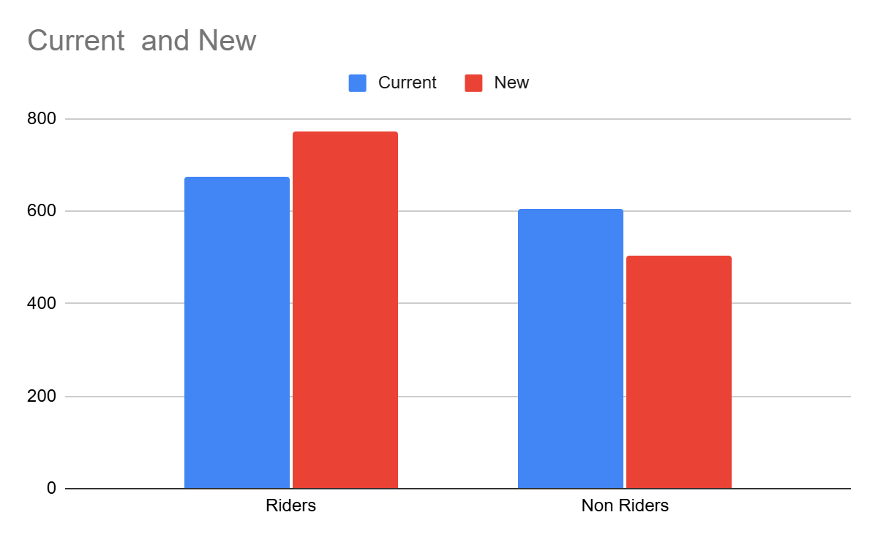
Shuttle New Route: Current Route v New Route Riders
Riders
Current - 673
New - 774
Non Riders
Current - 605
New - 504

Slide 12
Shuttle New Route: Data Still Compiling
Student only - broken down by campus (CAS, GSEC, Law)
All respondents (student + employee) - All Campuses
Employee - All Campuses

Slide 13
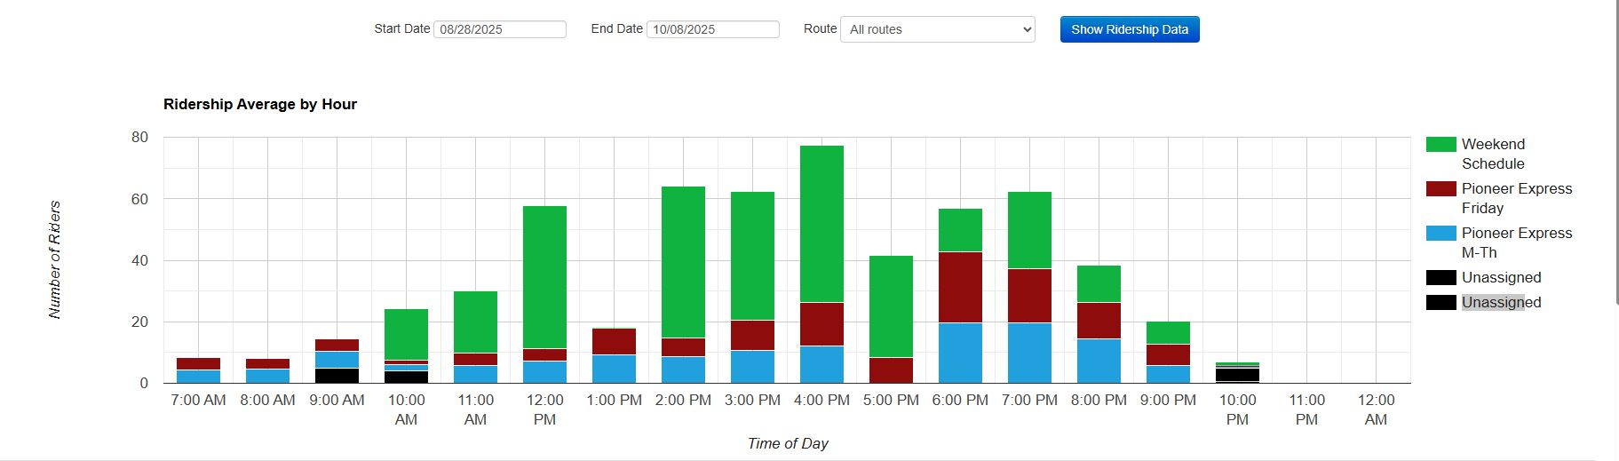
New Shuttle Route: Current Route Historical Data - All Routes

Slide 14
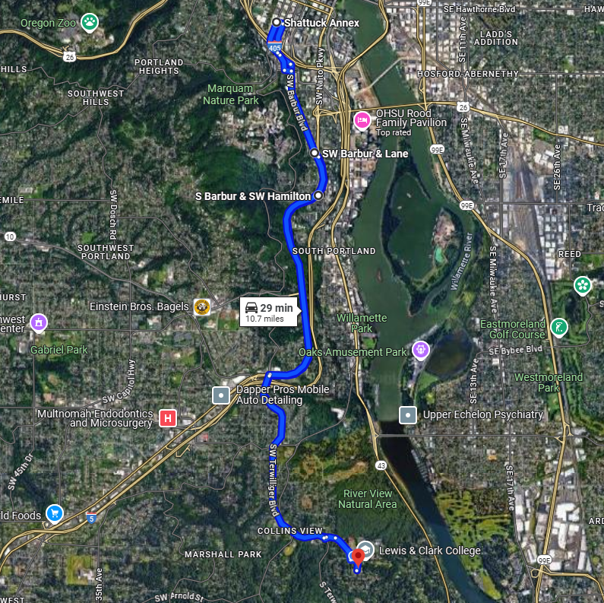
Current Route - Weekday

Slide 15
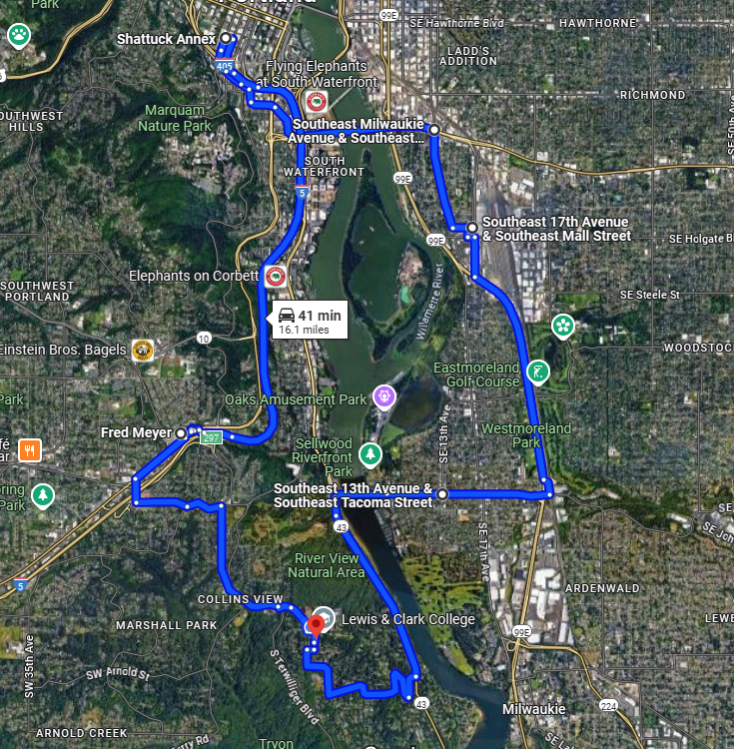
Current Route - Weekend

Slide 16
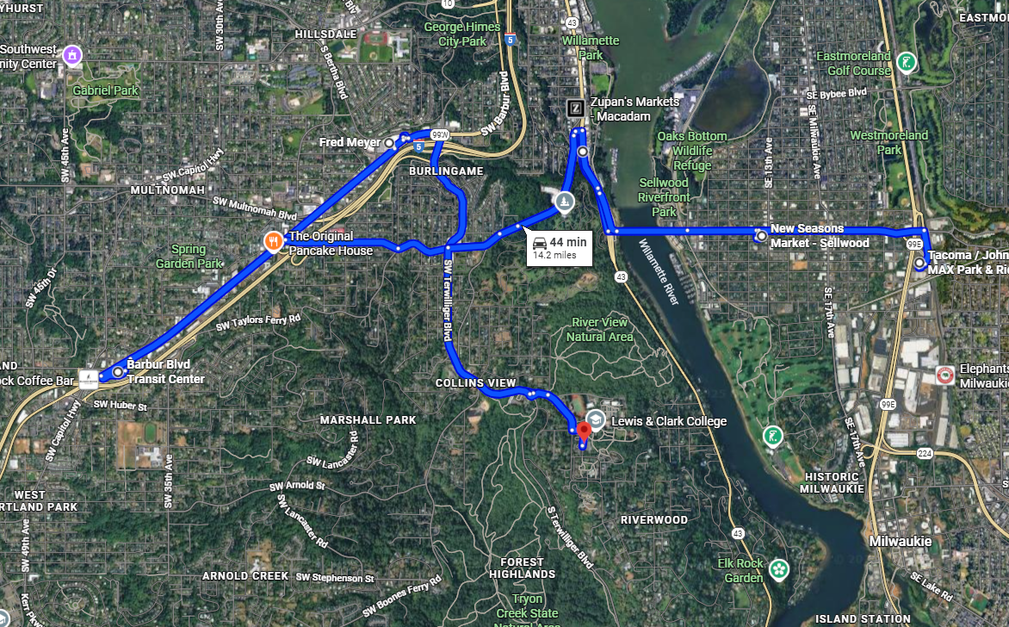
Proposed Route

Slide 17
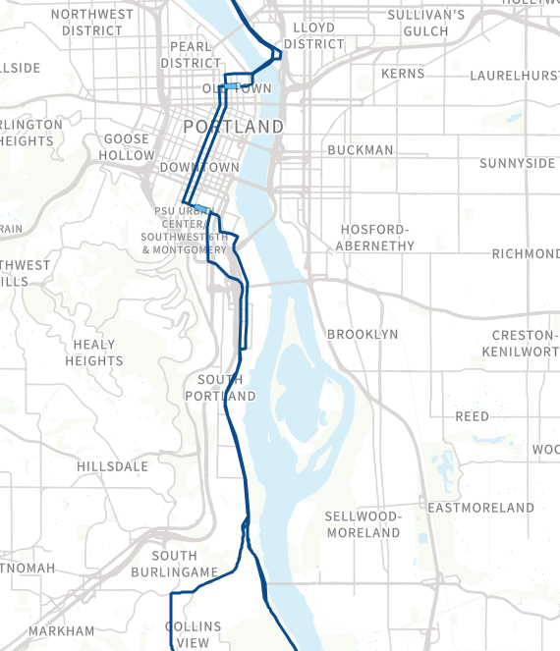
TriMet Overlap
TriMet 35T
Current Shuttle Route

Slide 18
Shuttle New Route
Pros | Cons
Connects students to Sellwood | Lose Downtown Service (PSU/Barbur)
Transit Hubs add multiple bus lines and Orange MAX giving students much more access to Portland. | Law clinics no longer in service area (Still covered via TriMet)
Cost Savings ~ $60,000/year (possible re-allocation to add transportation or other services?) | 2-3 Less overall trips/day (due to traffic)
Additional Grocery Store Access (New Seasons)
Reduce likelihood of losing 35T

Slide 19
Possible Financial Redistribution Options
Increase TriMet Subsidy to 100%
  Select Groups (certain approved program, CAS students only, etc)
  All LC Community
Create Low Income Parking Permit Program
Parking Infrastructure Improvements
  EV Charger Replacement (and potential to add more)
  Curb and asphalt repairs
  Improve/replace signage
  Additional LPR Camera Systems (Campus Safety vehicles or gates)
Internal Fleet - Rental Program
  Student Group Access
Holiday Shuttle Service

Slide 20
EV Chargers
Working on RFP with 2 EV Charging Companies
  Smart Charge America (SGA)
  ChargePoint
College Funded v Host Models
  SCA offers both options
  ChargePoint only offers College Funded
College Funded
  Budget ~$35,000
  SCA - Replacement of existing chargers, plus adding 2
  ChargePoint - 4 replacements
Host Model
  SCA incurs all install/hardware expenses
  Retain 100% of all charging revenue
  LC retains 100% idle time Revenue
  LC responsible for electric bill (idle time rev could offset)
Grant Opportunity (only for College Funded)

Slide 21

Open Discussion / Questions

