Slide 1
Lewis & Clark
Transportation and Parking Advisory Committee (TPAC)
October 8, 2025 | 1:00 PM | Fowler 353

Slide 2
Agenda
T&P Update
LC Shuttle
EV Chargers
Open Discussion / Questions

Slide 3
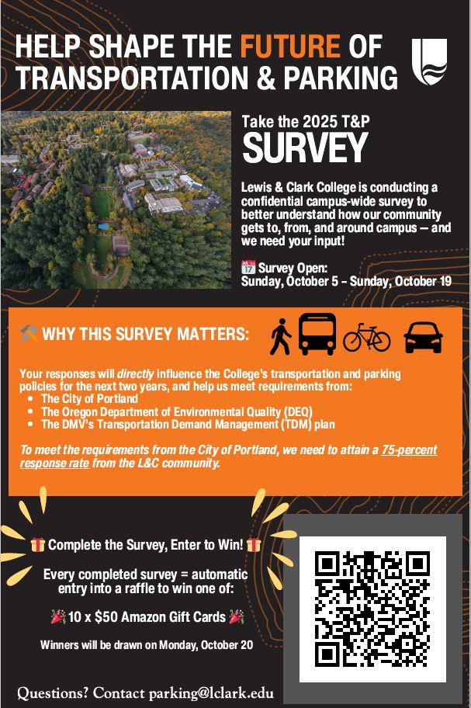
T&P Update: T&P Survey
Dates: Sun, 10/5 - Sun, 10/19
Bi-Annual Report Required for:
  DEQ/DMV - Oct 30
    75% minimum return rate required
  Transportation Demand Mgmt Plan - 12/31
Proposed Shuttle Route Change
Raffling 10, $50 Amazon Gift Cards - Drawing on Mon, Oct 20

Slide 4
T&P Update: Permit Sales & Citations
Permit Sales (Current YTD/ Last Year Same Period):
  Fall Semester: 752 / 744
  Annual: 1,186 / 1,140
  Total: 1,949 / 1,884
  *numbers include daily semester permits & carpool, but exclude TriMet & day passes
Day Passes (Current YTD / Last Year Same Period):
  Total: 1,669 / NA
  Portal: 994 / 869
  QR Codes: 675 / NA
Citations (Current YTD / Last Year Same Period):
  Total: 561 / 779

Slide 5
T&P Update: Fountain Gateway Church
Campus Saftey have begun doing twice/daily vehicle counts ***
Raw Data So far..
  Lot size: 56
  Highest vehicle count: 21 (38% of lot)
    Occurred once
  Lowest vehicle count: 1 (2% of lot)
    Occurred Once
  Avg vehicle count: 8
  Avg vehicle removing outliers (highest/lowest): 9
  Avg afternoon count: 14 ****
Monthly Lease / ROI
  $1,300/mo**
  ROI based on estimated daily usage: 660 monthly vehicles / $1300: $2/car/day
  ROI based on estimated person count: $43/person

Slide 6
Shuttle New Route
Stops on New Route
  Fowler > Law School > Fred Meyer (All day) > Barbur Transit > New Seasons (Se Tacoma) > SE Tacoma Park and Ride (Orange MAX) > Law School > Fowler
  Fountain Gateway Church Still flag stop
  1 trip/hr
Stops no longer being serviced
  Barbur Blvd (both directions)
  PSU (Shattuck Hall)
Weekend Route will Remain Unaffected (potentially try to add SE Tacoma Park and Ride)
Reduce operating hours (M-Th) by 1 hour ending at 9p

Slide 7
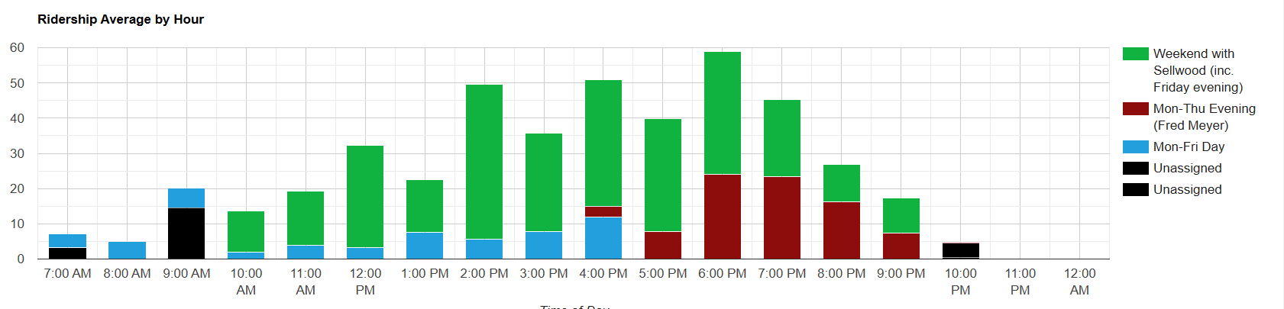
Shuttle Ridership (March)

Slide 8
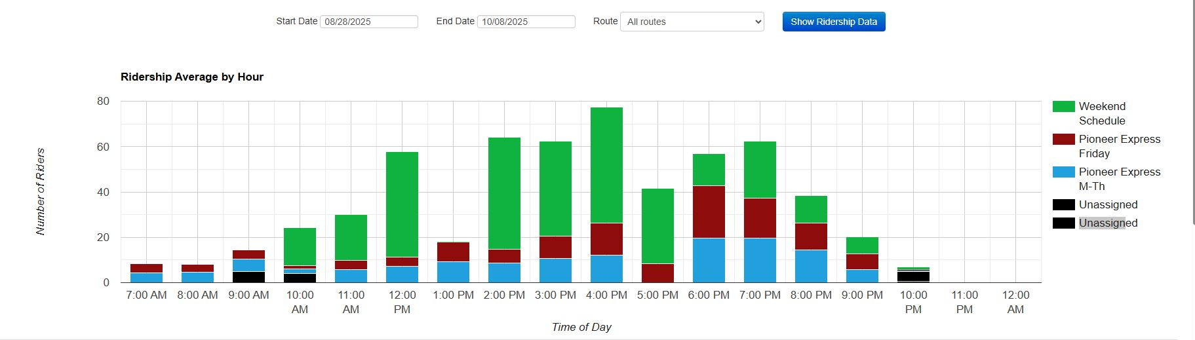
Shuttle Ridership (YTD) - All Routes

Slide 9
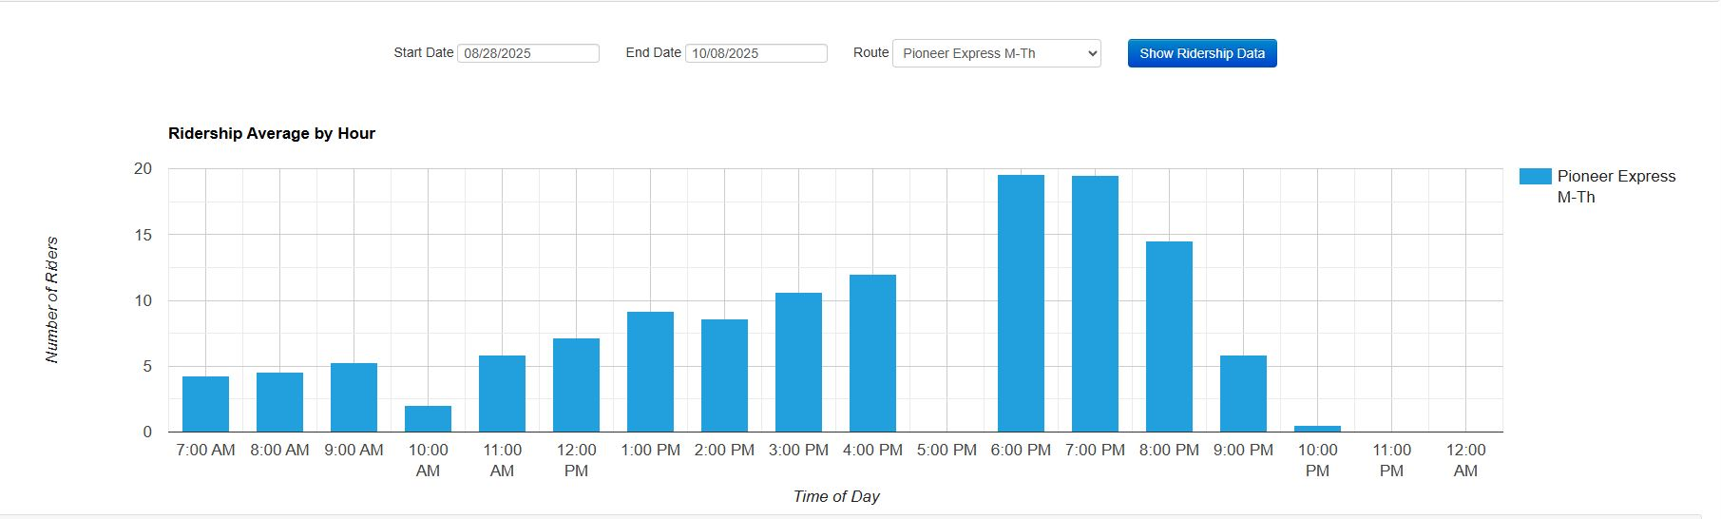
Shuttle Ridership (YTD) - Weekday (M-Thur)

Slide 10
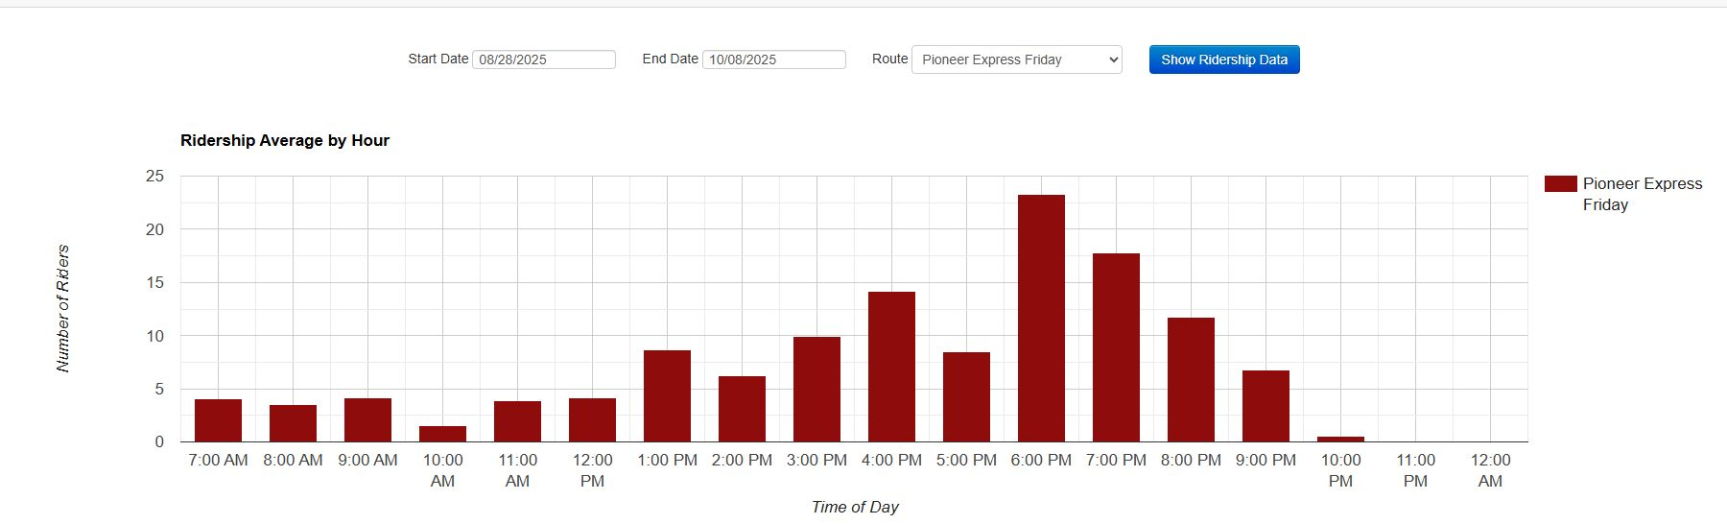
Shuttle Ridership (YTD) - Friday

Slide 11
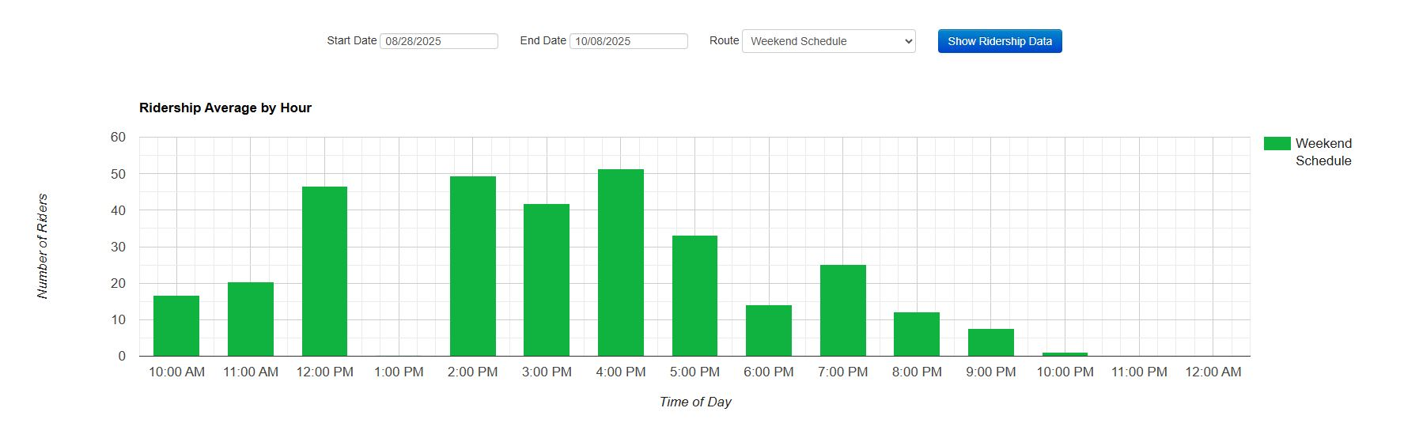
Shuttle Ridership (YTD) - Weekend (Sat/Sun)

Slide 12
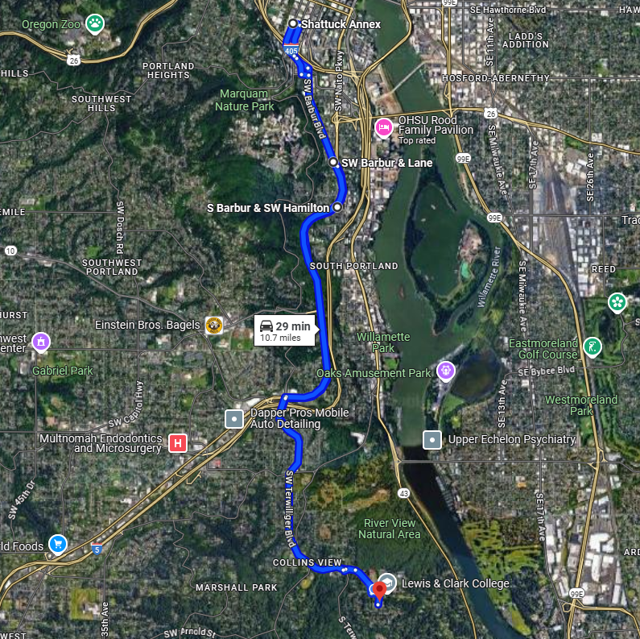
Current Route - Weekday

Slide 13
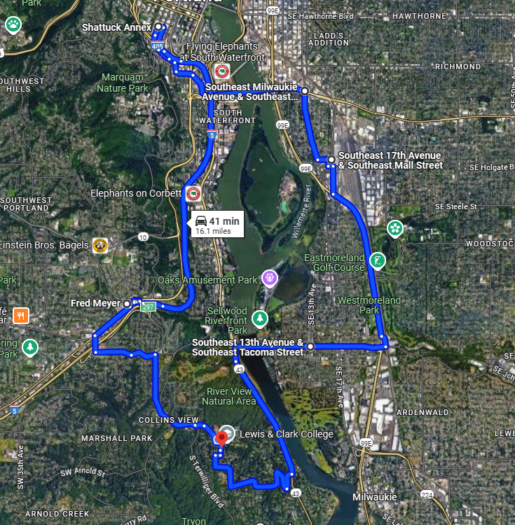
Current Route - Weekend

Slide 14
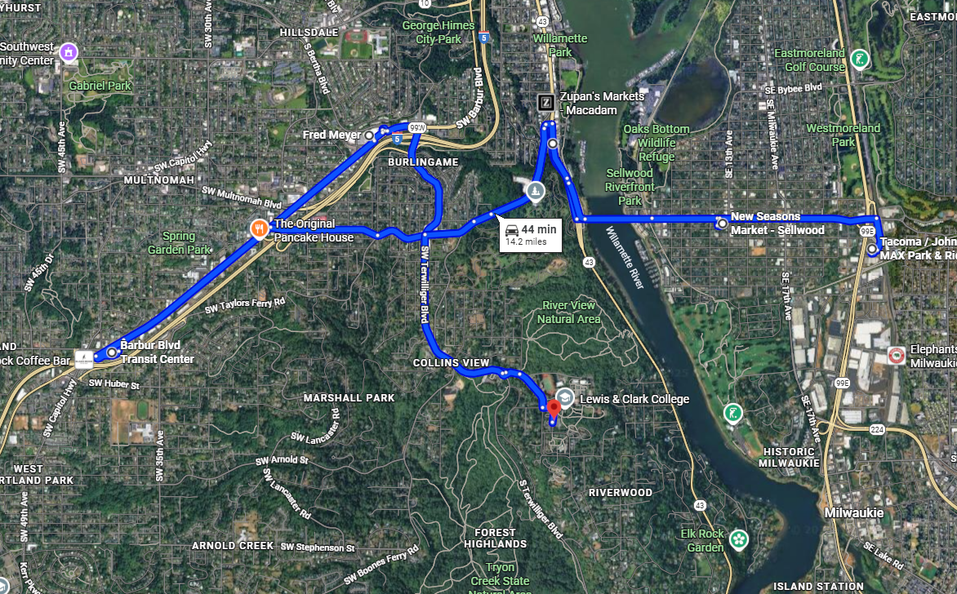
Proposed Route

Slide 15
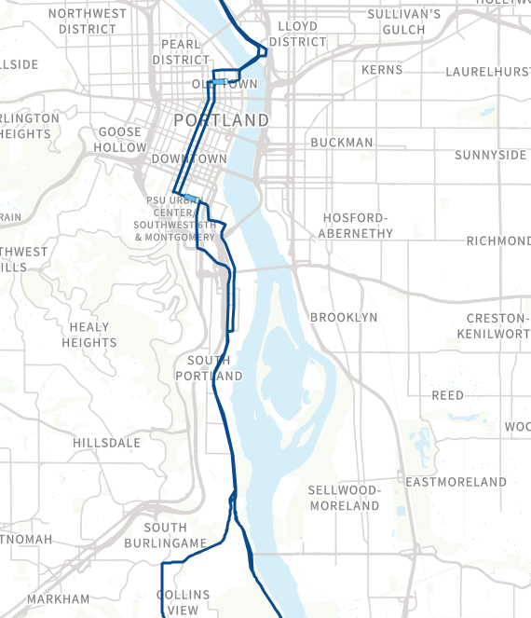
TriMet Overlap
TriMet 35T
Current Shuttle Route

Slide 16
Shuttle New Route
Pros | Cons
Connects students to Sellwood | Lose Downtown Service (PSU/Barbur)
Transit Hubs add multiple bus lines and Orange MAX giving students much more access to Portland. | Law clinics no longer in service area (Still covered via TriMet)
Cost Savings ~ $60,000/year (possible re-allocation to add transportation or other services?) | 2-3 Less overall trips/day (due to traffic)
Additional Grocery Store Access (New Seasons)
Reduce likelihood of losing 35T

Slide 17
Possible Financial Redistribution Options
Increase TriMet Subsidy to 100%
  Select Groups (certain approved program, CAS students only, etc)
  All LC Community
Create Low Income Parking Permit Program
Parking Infrastructure Improvements
  EV Charger Replacement (and potential to add more)
  Curb and asphalt repairs
  Improve/replace signage
  Additional LPR Camera Systems (Campus Safety vehicles or gates)
Internal Fleet - Rental Program
  Student Group Access
Holiday Shuttle Service

Slide 18
Shuttle Route Feedback Sessions
3-5 coffee/donut/pizza info sessions with at least 1 hosted / campus
Need Volunteers To Assist

Slide 19
EV Chargers
Have Received quote for replacement
  $18,000 - $30,000 (replacement / add 2 plus replacement)
  Free Install in exchange for charging revenue
VPSL would like at least 2nd quote
Proposal to VPSL to present to EC

Slide 20

Open Discussion / Questions

